Slide 1
Healing Stress-Induced Damage in Nb₃Sn SRF Cavities
Eric Viklund

Slide 2
Mechanical Properties of Nb₃Sn Thin Films
Nb₃Sn is a brittle material.
Young’s Modulus: 130 GPa
Ultimate Tensile Stress: 100-180 MPa
Elongation at Break: 2-3 x 10⁻³
Thin films of Nb₃Sn break easily due to applied stresses.
Bussière, Jean F., H. LeHuy, and Bernard Faucher. Elastic Behavior of Polycrystalline Nb 3 Sn, V 3 Ga and Nb 3 Ge. Springer US, 1984.
E. Buechler, Tensile Stress-Strain Measurements of Nb3Sn Superconducting Strands and Cables at Room Temperature, Tufts University School of Engineering Medford, Massachusetts, 2017.

Slide 3
Nb₃Sn Thin Film Crack Following Grain Boundaries
Nb₃Sn thin film is further weakened by grain structure and surface roughness.
Nb₃Sn grain boundaries are typically etched due to the Sn vapor-diffusion process.
These grain boundaries act as stress concentrators.

Slide 4
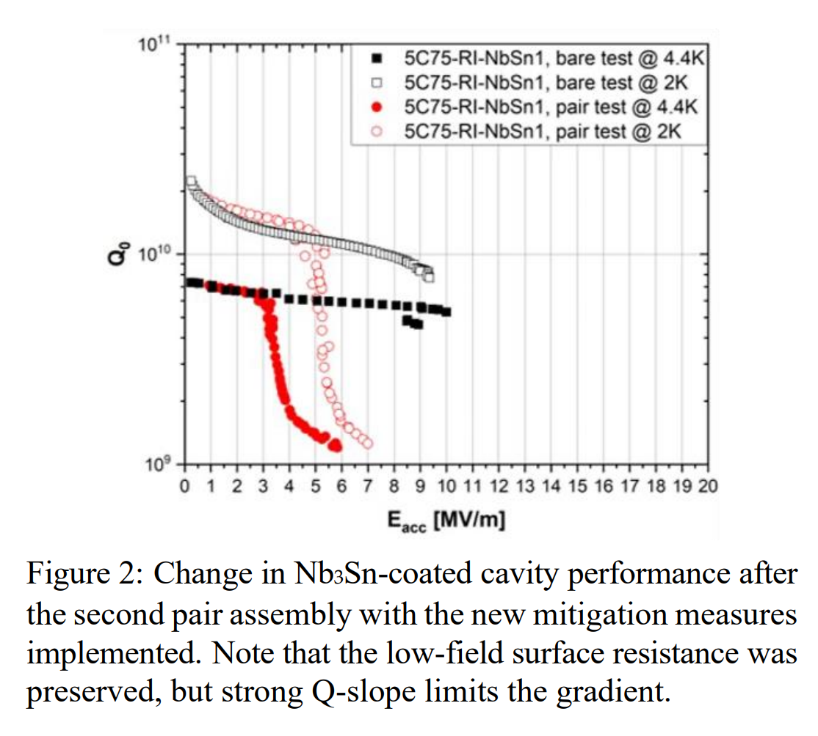
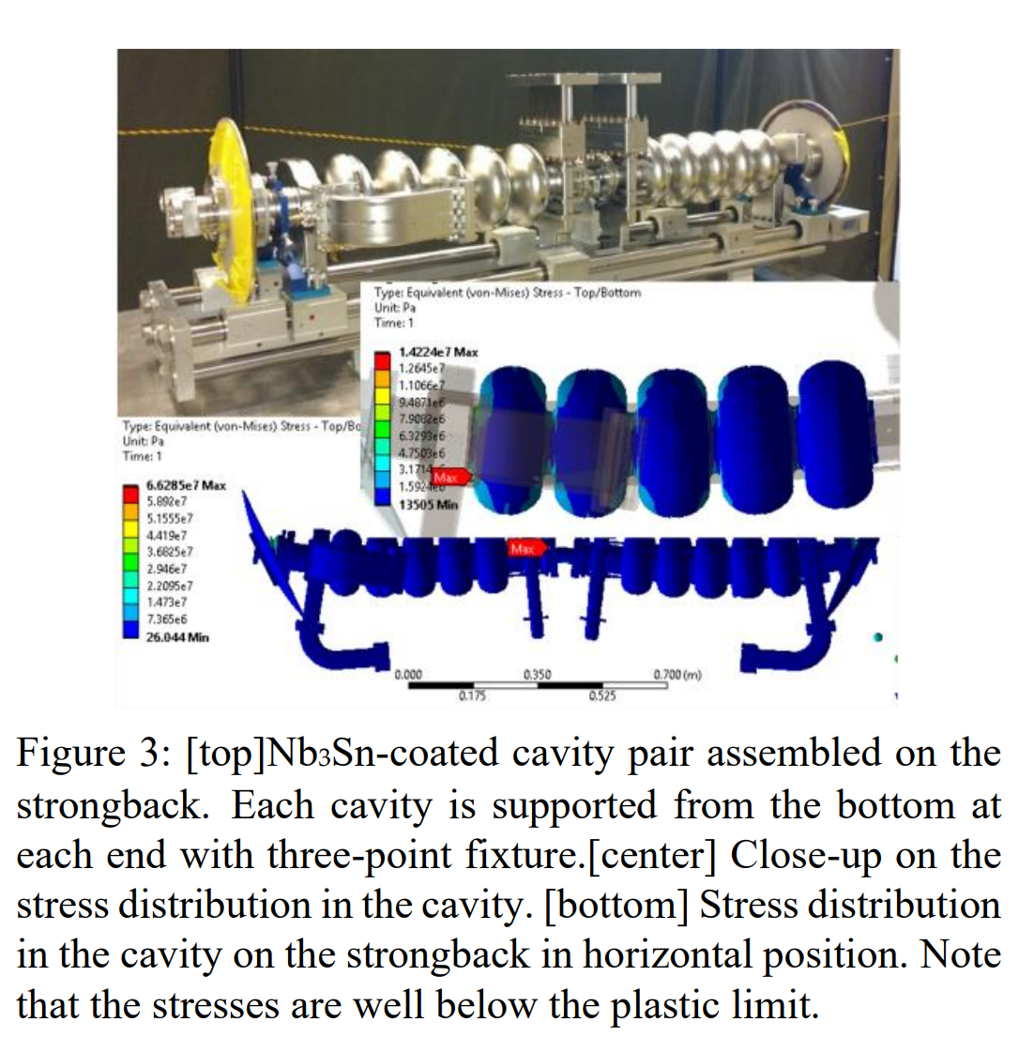
Performance Degradation of Nb₃Sn Cavities Due to Stress
Nb₃Sn Cavity Cryomodule for the Continuous Electron Beam Accelerator Facility (CEBAF) at Jefferson Laboratory.
Two 5-cell Nb₃Sn cavities were manufactured for this cryomodule.
Cavity performance was degraded between single cavity test and pair test.
Room temperature tuning.
Pair assembly.
Eremeev, Grigory, et al. "Preservation of the High Quality Factor and Accelerating Gradient of Nb3Sn-coated Cavity During Pair Assembly." arXiv preprint arXiv:2307.10268 (2023).

Slide 5
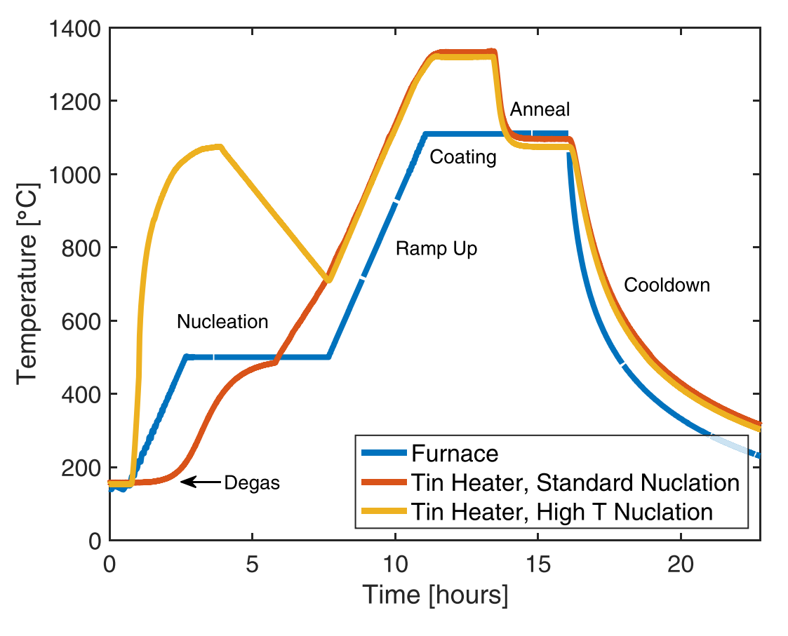
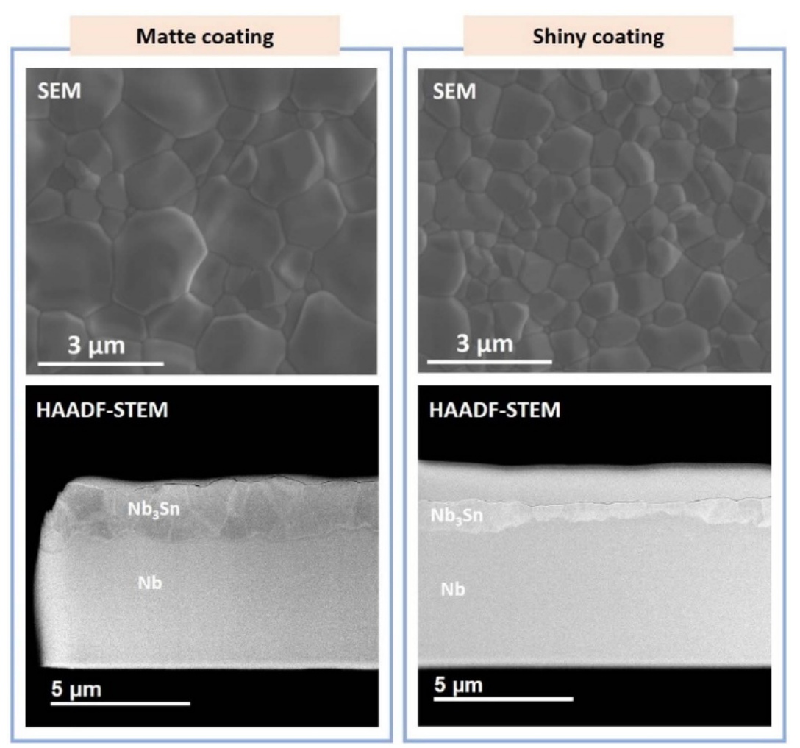
CBMMD-R
Coated using a modified high-temperature nucleation step resulting in a smoother, thinner Nb3Sn coating.
Was able to reach a record high accelerating gradient of 24 MV/m.
Performance was degraded in transport.
A recoating was applied to this cavity to attempt to recover the performance.
S Posen et al 2021 Supercond. Sci. Technol. 34 025007

Slide 6
Recoating Procedure
A recoating procedure was applied to the cavity to attempt to fix the degradation.
1000 ˚C for 1 hour
0.85 g of Sn
After the coating most of the Sn was left unevaporated in the crucible.
The small amount of Sn should have a negligible effect on the film thickness.
This process is effective at healing performance degradation in centrifugal barrel polished (CBP) Nb₃Sn cavities.

Slide 7
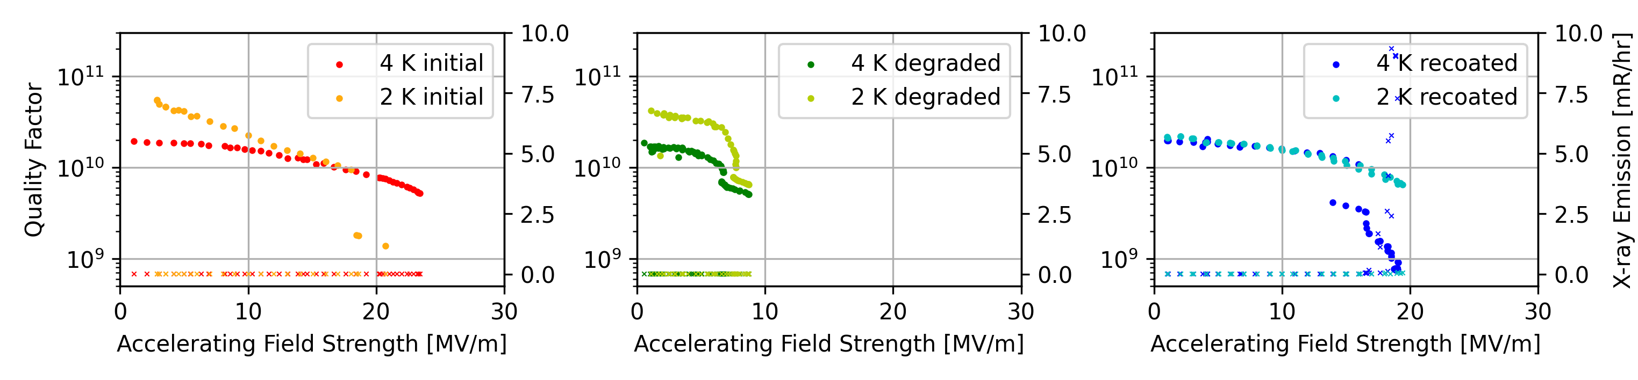
VTS Data
After the recoating, the cavity performance was greatly improved over the degraded performance but did not entirely recover the original performance.
Recoated cavity showed high X-ray emissions before quench, which could indicate that field emission contributed to the quench.

Slide 8
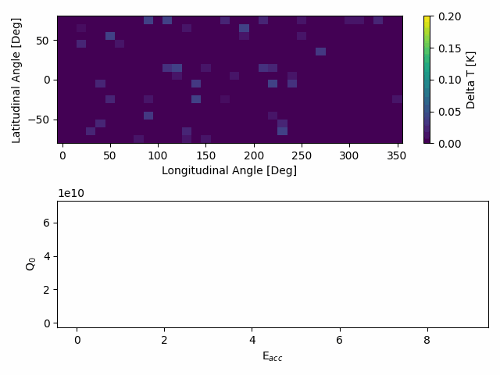

Temperature Mapping
Pre-Recoating
Post-Recoating

Slide 9
Healing Process Theory
Cracks in the film lead to performance degradation.
Sharp edges cause magnetic field enhancement.
Cracks that penetrate to the substrate force currents to flow through the Nb substrate.
Two possible mechanisms for healing cracks.
Liquid Sn is deposited in the crack and Nb diffuses into the crack to create new Nb₃Sn.
Sn vapor diffuses into the bottom of the crack and reacts with the Nb substrate.

Slide 10
Concluding Remarks
There is a lack of experimental data on the mechanical properties of Nb₃Sn thin films. Existing studies focus on Nb₃Sn-Nb composite foils and cables for magnet applications.
Nb₃Sn cavities are sensitive to mechanical stresses. This complicates the manufacturing process compared to Nb cavities.
A recoating procedure can partially heal the damaged film eliminating the need to strip and recoat the cavity.

